Slide 1

Noida institute of Engineering & Technology
Department of CSE (AI)
Session (2023-24)
Department of CSE (AI)
Session (2024-25)
Mini Project (ACSE0459) Presentation on
“Hand Gesture Volume Control”
Project Guide: Submitted To: Group- Member:
Dr.Garima Jain Dr.Garima Jain SHAHIL AHMAD (2201331520157)
Asst. Prof. CSE(AI) UNNATIDHAR SHARMA (2201331520229)
MOHAMMAD MAHFOOJ (2201331520104)

Slide 2

Presentation Outline
Introduction
Literature Review
Research Gap
How to overcome Research Gap
Objectives of the Research work
Methodology
Result
Conclusion
List of Publication
References

Slide 3
Introduction
The Hand Gesture Volume Control revolutionizes sound control by allowing users to adjust volume levels through simple hand movements.
This innovative technology provides a seamless and intuitive way to manage audio without physical interaction with devices.

Slide 4
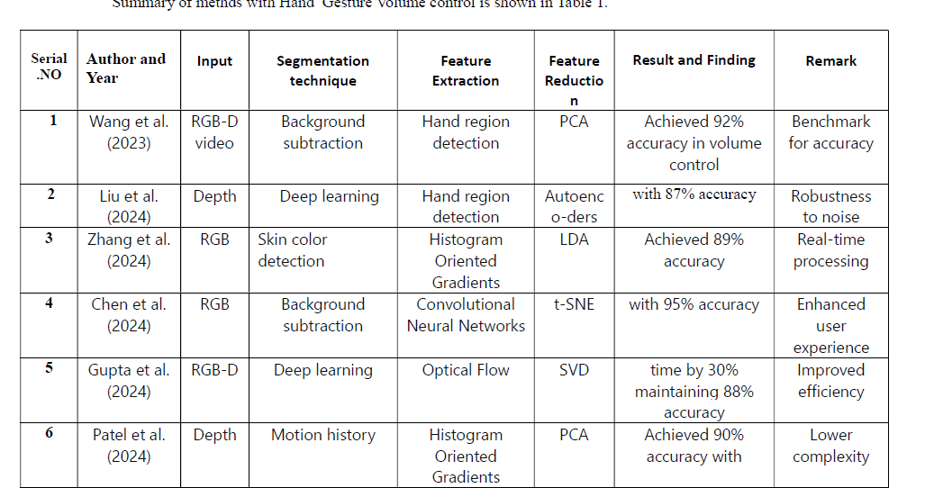
Literature Review

Slide 5
Research Gap
Accuracy and Consistency: One potential research gap could be improving the accuracy and consistency of hand gesture recognition for volume control.
Real-time Performance: Another gap could be enhancing real-time performance, ensuring that the system responds promptly and accurately to user gestures without delays or errors.
Robustness: Research could focus on making the system more robust against interference from other objects or gestures, ensuring that it accurately interprets only the intended volume control gestures.
User Experience: Investigating the user experience aspect could be another gap. This involves studying user preferences, ergonomic considerations, and ease of use to design a system that is intuitive and user-friendly.
Adaptability: Research could also explore the adaptability of the system to different users with varying hand sizes, shapes, and mobility capabilities, ensuring inclusivity and accessibility.

Slide 6
Objective of the Research work
> In this paper discusses the significance of gesture control in technological
advancements for people with visual impairments. It highlights the use of
computer vision and the main objective of the project, which is to control
computer settings using hand gestures.
> The project focuses specifically on the needs of people with certain disabilities,
here, the volume control using hand gestures, and incorporates the use of
OpenCV.
> The module utilizes a computer's webcam to capture images or videos, processes
them to extract necessary information, and performs volume
adjustments based on the input gestures.
> The program allows users to increase or decrease the volume without the need for
physical touch or input devices like the mouse or keyboard.

Slide 7
Methodology
Cv2
*CV2 module is the python interface for OpenCV, a powerfull open source library that provide a comprehensive set of functions for computer vision and image processing tasks.
Mediapipe :-
Real time hand Tracking.
pose estimation (Detecting people or object in an image or video)
Hand landmark detection* Distance calculation.
Pycaw :-
It act as bridge between python code and the underlying window code audio API.
Get the current volume level.
Increase or decrease the volume based on your gesture recognition logic.

Slide 8
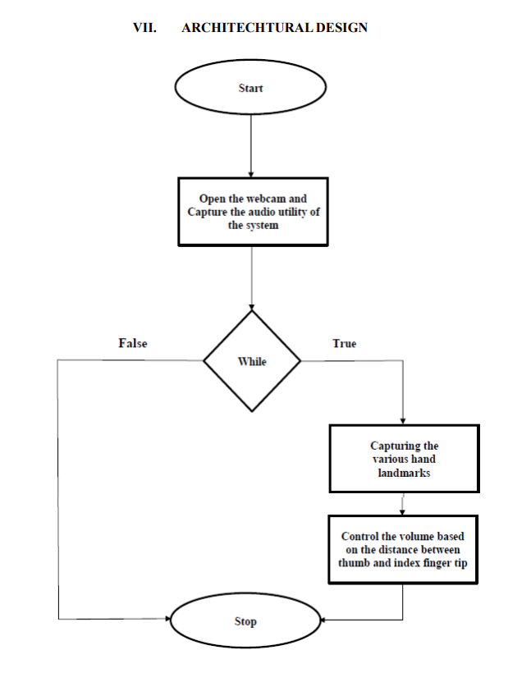
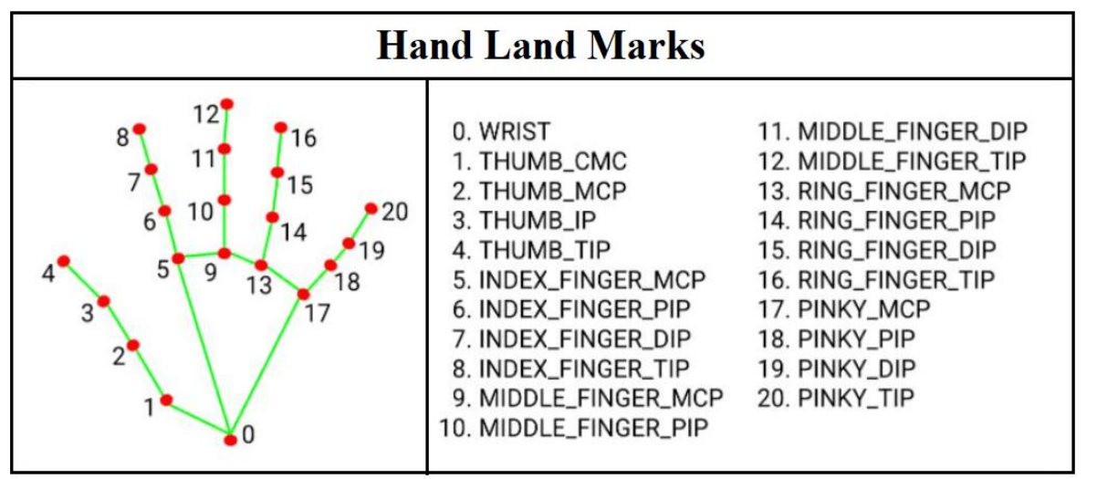
Methodology

Slide 9
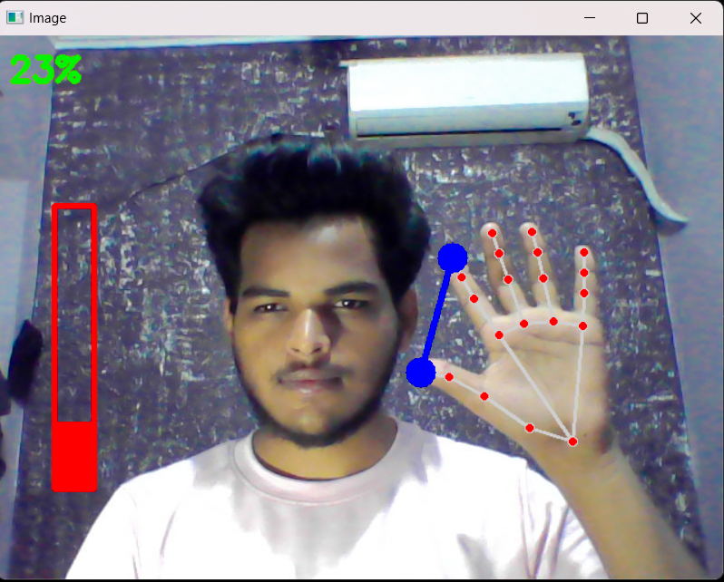
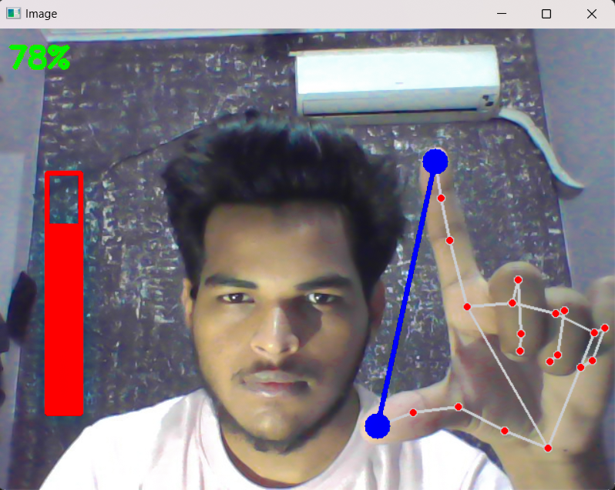
Result

Slide 10
Conclusion
The Gesture Based Volume Controller represents a significant advancement in sound control, offering a more intuitive, hands-free, and interactive approach to managing audio output. With its potential for widespread adoption and diverse applications, this technology is poised to revolutionize the way we interact with sound.

Slide 11
List of Publication
[1.] C. L. NEHANIV. K J DAUTENHAHN M KUBACKI M. HAEGELEC. PARLITZ
[2.] R. ALAMI "A methodological approach relating the classification of gesture to identification of
human intent in the context of human-robot interaction”, 371- 377 2005.
[3.] M. KRUEGER Artificial reality II Addison-Wesley Reading (Ma) 1991.
[4.] H.A JALAB "Static hand Gesture recognition for human computer interaction”, 1-72012. 4)
JC.MANRESARVARONAR. MASF.
[5.] PERALES” Hand tracking and gesture recognition for human-computer interaction", 2005.
[6.] Intel Corp, “OpenCV Wiki,” OpenCV Library [Online], Available:
http://opencv.willowgarage.com/wiki .
[7.] Z. Zhang, Y. Wu, Y. Shan, S. Shafer. Visual panel: Virtual mouse keyboard and 3d controller with
an ordinary piece of paper. In Proceedings of Perceptual User Interfaces, 2001.
[8.] W. T. Freeman and M. Roth, Orientation histograms for hand gesture recognition. International
workshop on automatic face and gesture recognition. 1995, 12: 296- 301.

Slide 12
References
YOUTUBE
GOOGLE SCHOLAR

Slide 13
Thank you

